Slide 1
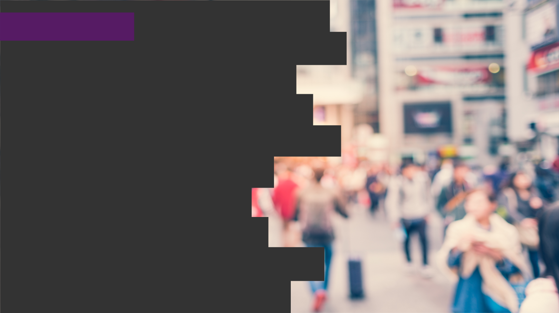

2020
Netcoreconf
Azure Durable Functions: Detrás de la magia
Juan Carlos Martinez
Luis Mañez
18/01/2020
Technical architect “Mr. Connect” (ClearPeople LTD)
Cloud Solutions Architect (ClearPeople LTD)
@jcmartinezg23
@luismanez

Slide 2
Sponsors

Slide 3
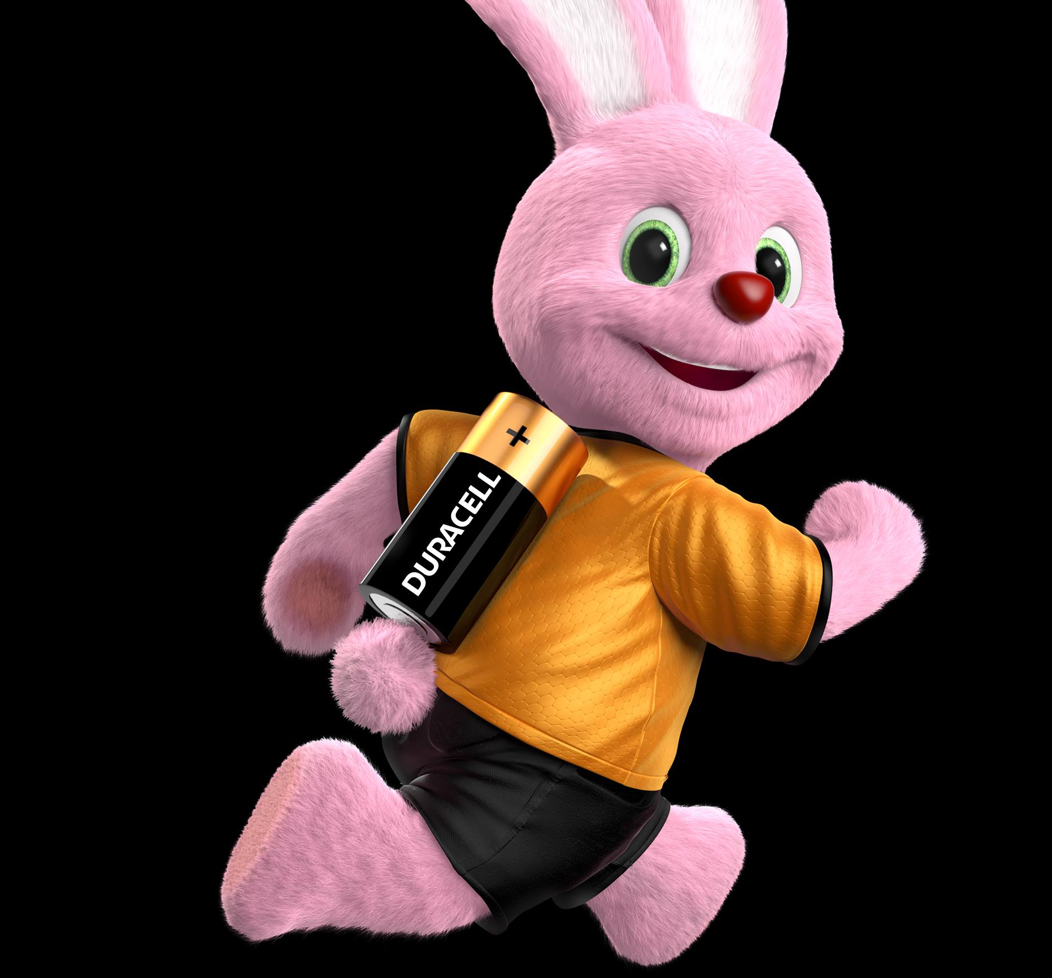
What are
“Azure Durable Functions”?

Slide 4
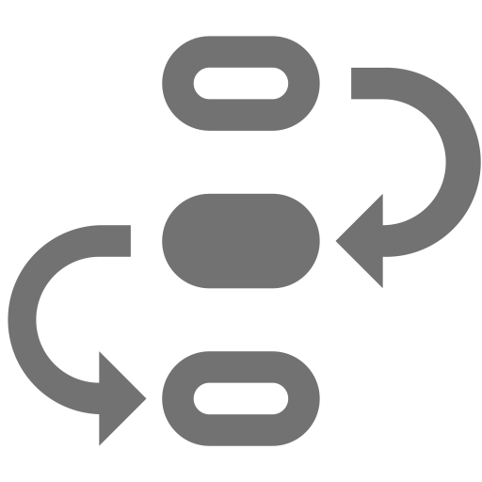


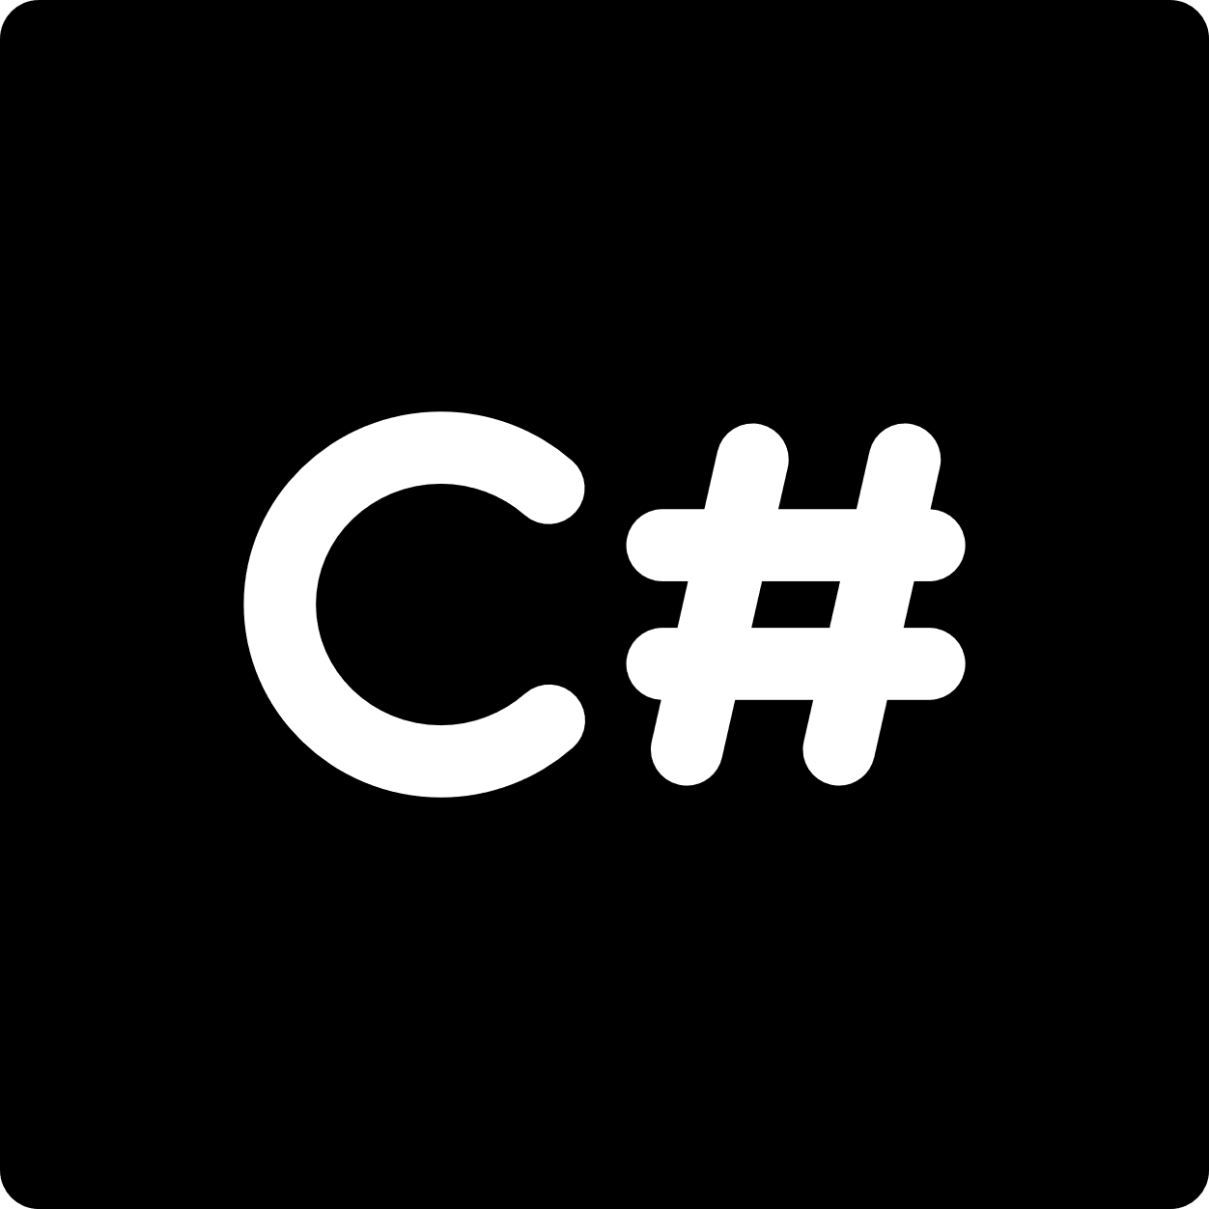

stateful functions in
serverless environment
workflow in code
azure functions extension
languages
F#

Slide 5
Event Sourcing

Slide 6
To complete by Juan Carlos.
This article and images are quite explanatory… https://docs.microsoft.com/en-us/previous-versions/msp-n-p/jj591559(v=pandp.10)?redirectedfrom=MSDN

Slide 7
Durable Functions Application Patterns

Slide 8
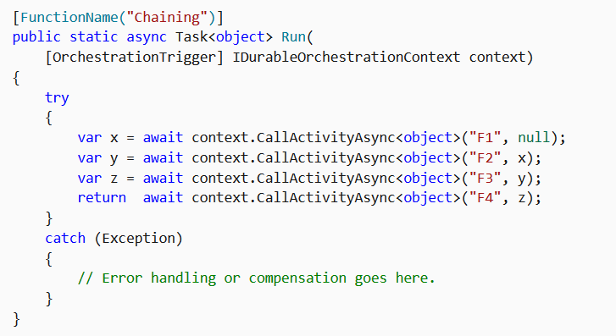
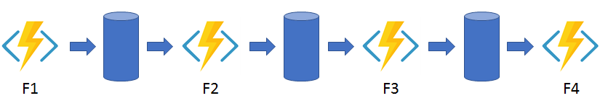
Function chaining

Slide 9
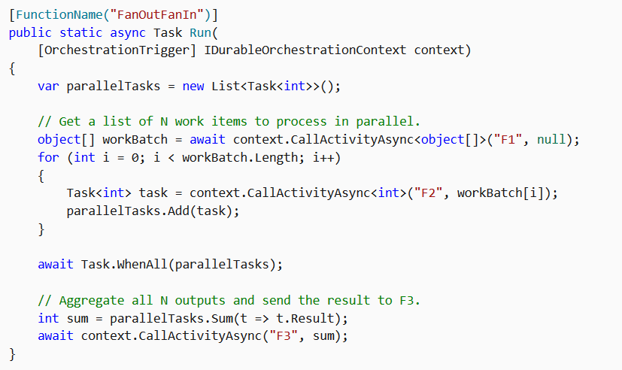
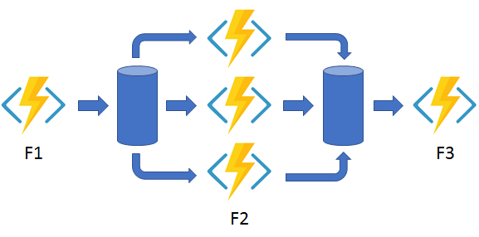
Fan out/fan in

Slide 10
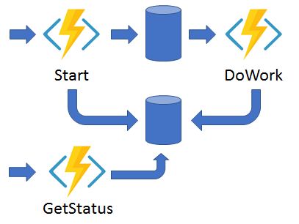
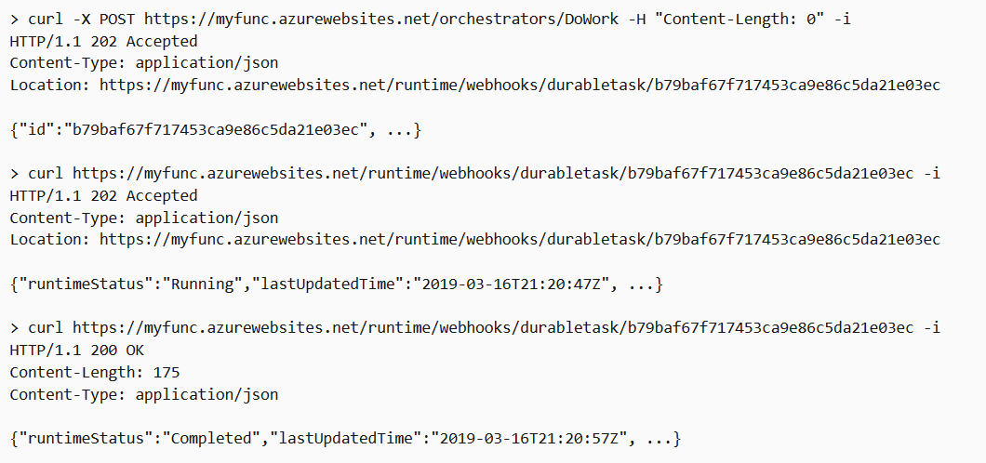
Async HTTP APIs

Slide 11
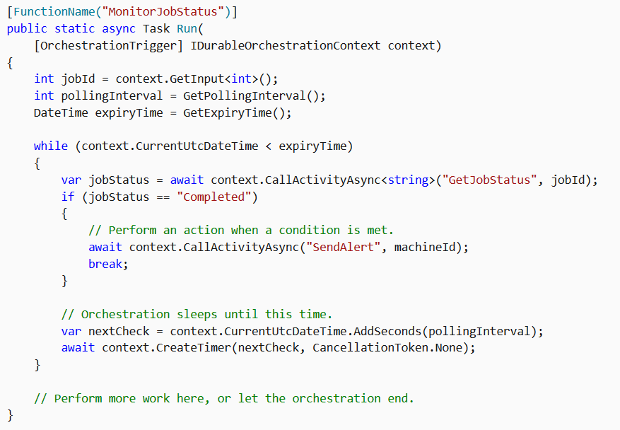
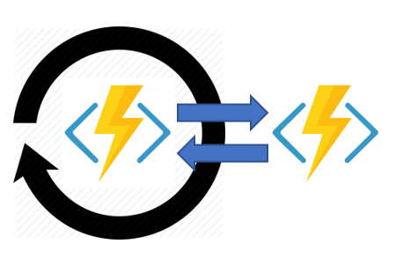
Monitor

Slide 12
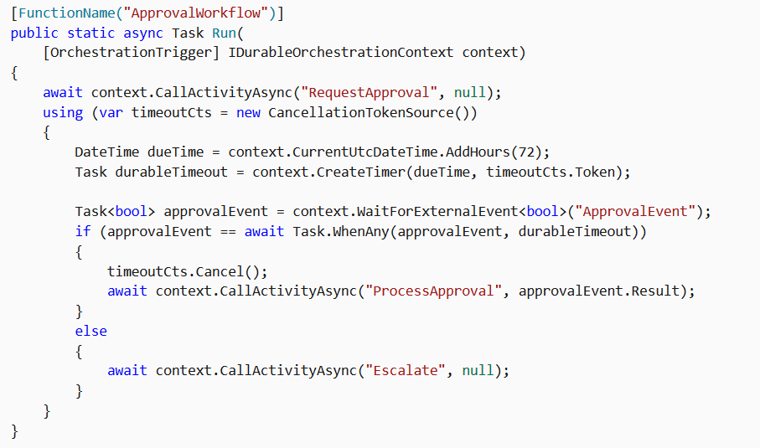
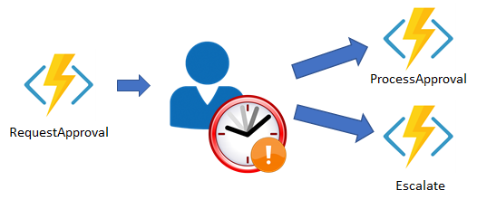
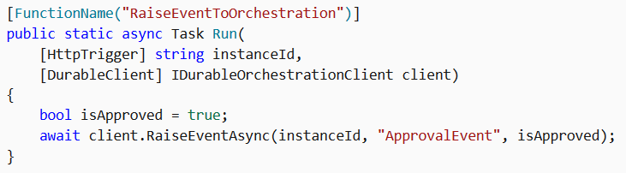
Human interaction
curl -d "true" http://localhost:7071/runtime/webhooks/durabletask/instances/{instanceId}/raiseEvent/ApprovalEvent -H "Content-Type: application/json"

Slide 13
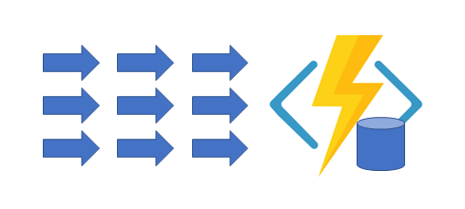
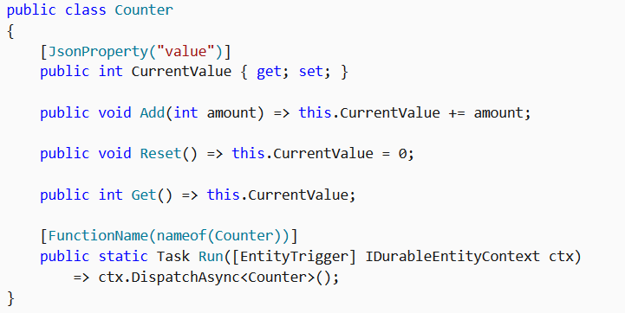
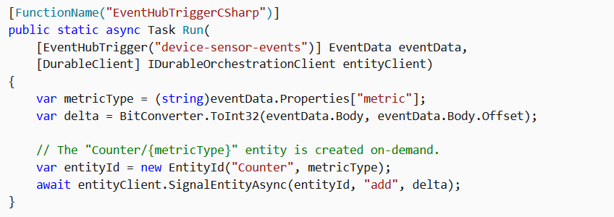
Aggregator

Slide 14
Orchestrator function code constraints

Slide 15
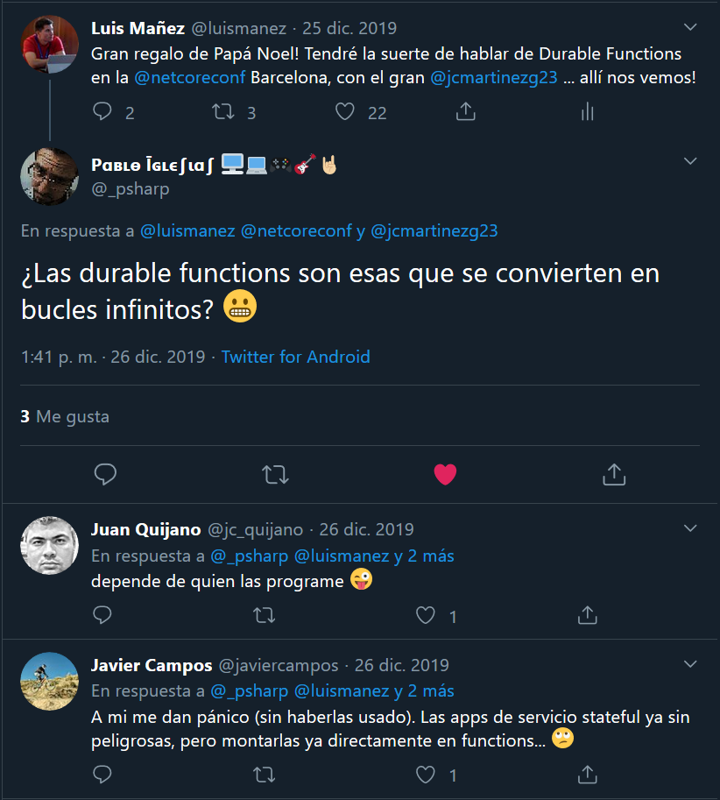

Slide 16
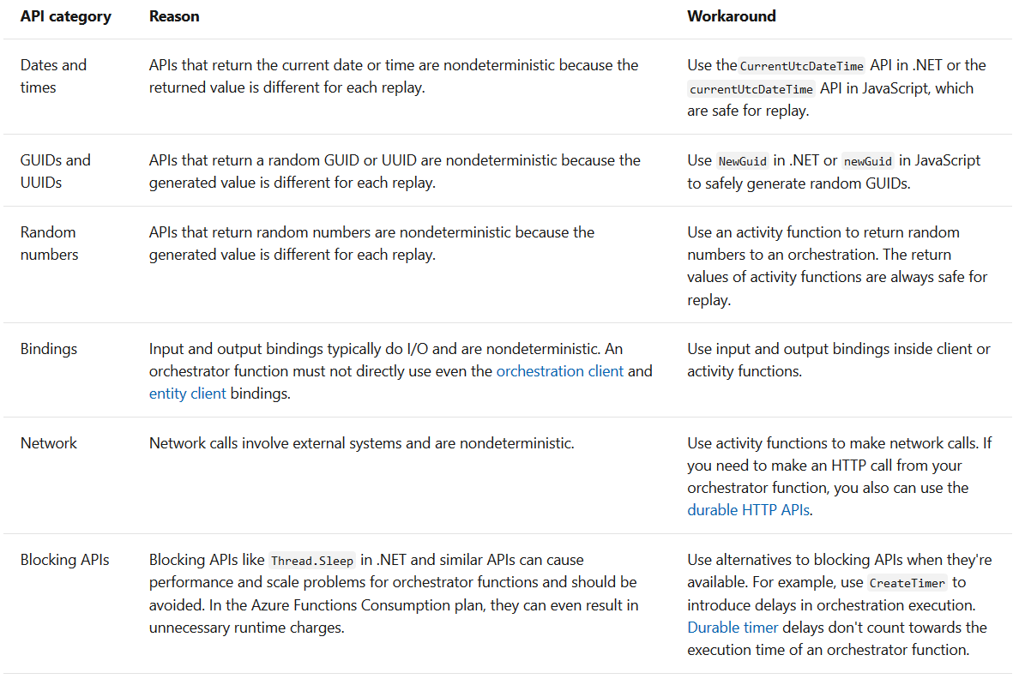
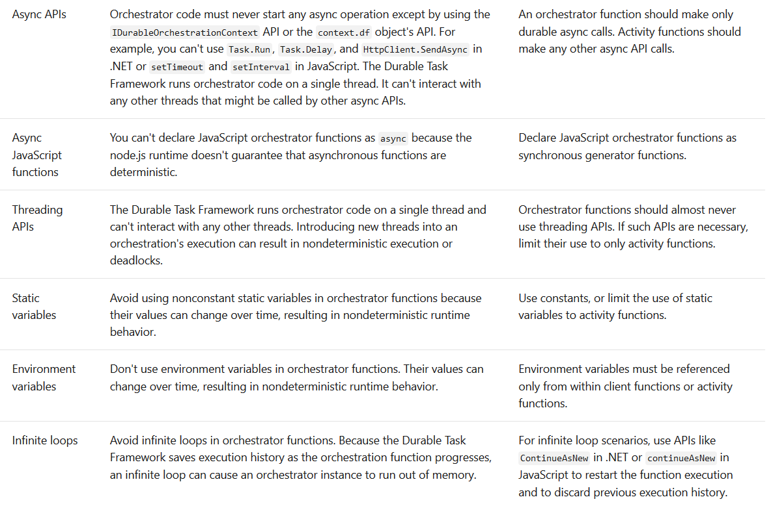
https://docs.microsoft.com/en-us/azure/azure-functions/durable/durable-functions-code-constraints

Slide 17
That´s cool… Can you show me some code?

Slide 18
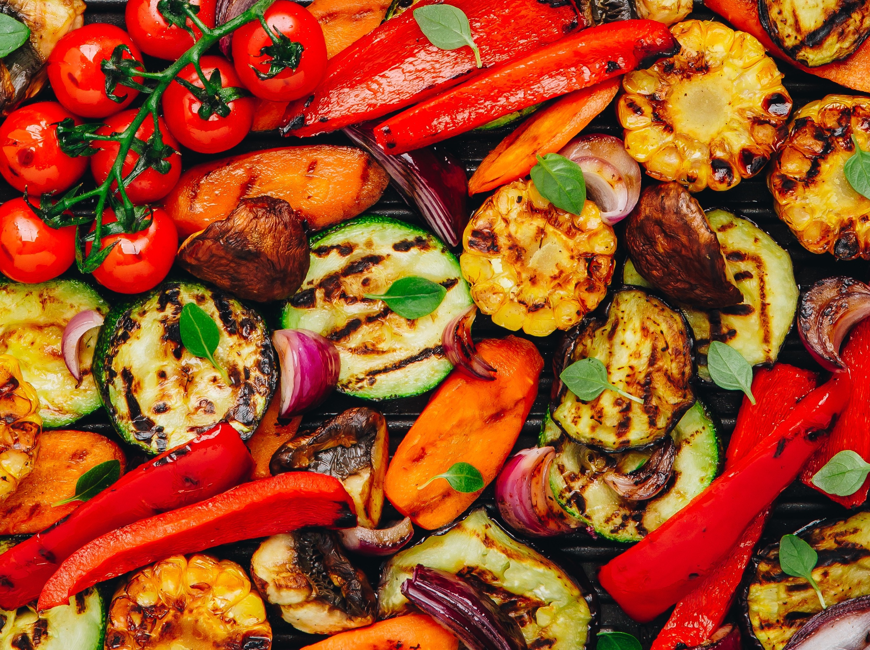

Instanyam!
Making #foodielovers since 2020

Slide 19
https://github.com/luismanez/netcoreconf-bcn-2020

Slide 20
Sponsors

Slide 21
Más información:
info@netcoreconf.com
@Netcoreconf
Visítanos en:
netcoreconf.com
GRACIAS

